Slide 1
CHAPTER 22 (Samuelson & Nordhaus ) Consumption and Investment

Slide 2
Outline of the Chapter:
Introduction
Consumption and saving
Budgetary Expenditure Patterns
Consumption, Income, and Saving
The Consumption Function
The Saving Function
The Marginal Propensity to Consume
The Marginal Propensity to Save
National Consumption Behavior
The National Consumption function
Alternative Measure of Saving

Slide 3
Outline of the Chapter:
Investment:
Meaning of Investment
Determinant of investment
Revenues
Costs
Expectations
The investment Demand Curve
On to the theory of aggregate Demand

Slide 4
Inside the macroeconomy: AS and AD
(AS) refers to total quantity of goods and services that a nation is willing to produce and sell in a given period of time.
It depends upon the price level, the productive capacity (potential output which in turn is determined by availability of productive inputs and managerial and technical efficiency) of the economy, and the cost level.
(AD) is the amount that different sectors in the economy willingly spend in a given period.
(AD) = C + I + G +NX
It is affected by price, fiscal and monetary policies.

Slide 5
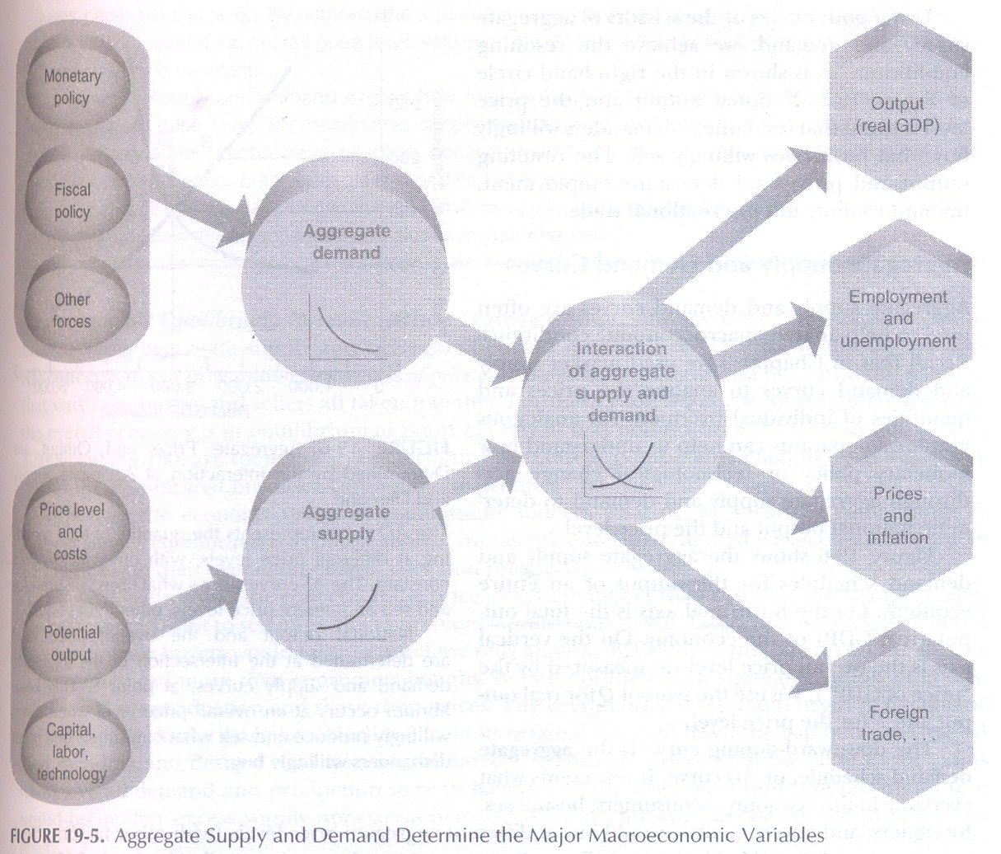
How do different forces interact to determine overall economic activity?
Different factors affecting overall economic activity. on the left: major variables determining agg supply and demand. The chief outcomes are shown on the right side.

Slide 6
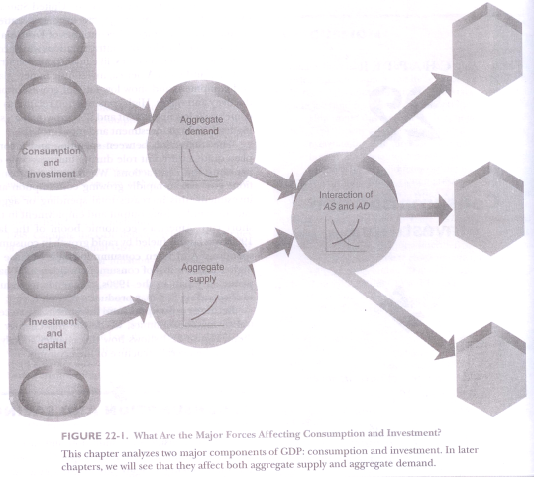
FIGURE 22-I . What Are the Major Forces Affecting Consumption and Investment?

Slide 7
Consumption
Why are we interested in national consumption and saving trends?
When consumption changes sharply, the change is likely to affect output and employment through its impact on aggregate demand.
Additionally, consumption behavior is crucial because what is not consumed—that is saved is available to the nation for investment in new capital goods; capital serves as a driving force behind long-term economic growth.

Slide 8
INVESTMENT
Investment plays two roles in macroeconomics.
Investment plays a dual role, affecting short-run output through its impact on aggregate demand and influencing long-run output growth through the impact of capital formation on potential output and aggregate supply.

Slide 9
Budgetary Expenditure Patterns
No two families spend their disposable incomes in exactly the same way. Yet statistics show that there is a predictable regularity in the way people allocate their expenditures among food, clothing, and other major items.
Poor families must spend their incomes largely on the necessities of life: food and shelter.
As income increases, People eat more and eat better. Consequently, the proportion of total spending devoted to food declines as income increases.

Slide 10
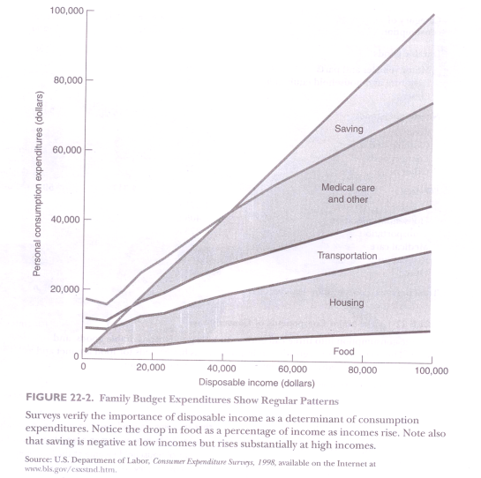
FIGURE 22-2. Family Budget Expenditures Show Regular Pattern

Slide 11
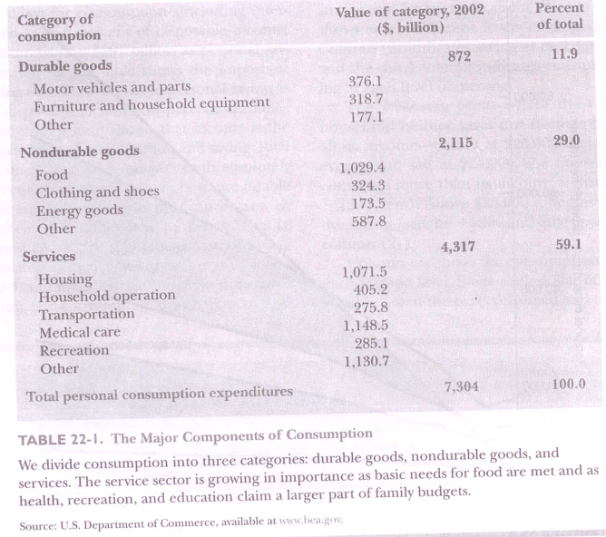
TABLE 22- I . The Major Components of Consumption

Slide 12
Consumption
"Engel's Laws” talks about the average behavior of consumption expenditure does change fairly regularly with income.

Slide 13
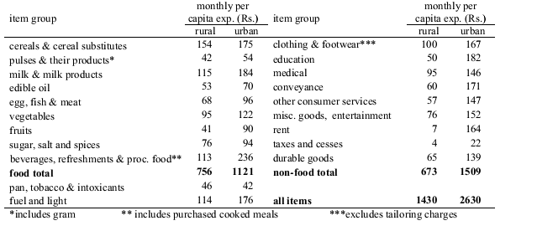
Break-up of Monthly Per Capita Expenditure by Consumers-All-India in 2011-12
Source: NSSO

Slide 14
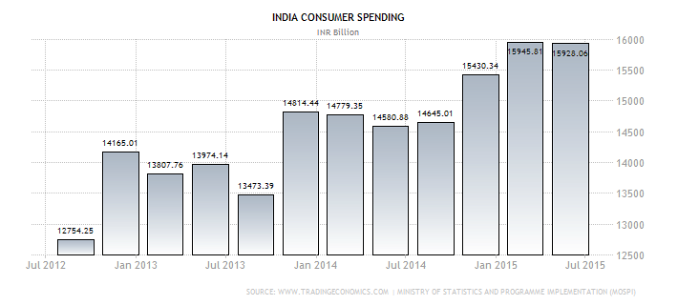
India Consumer Spending (July 2012- July 2015)
Source: www.Tradingeconomics.com

Slide 15
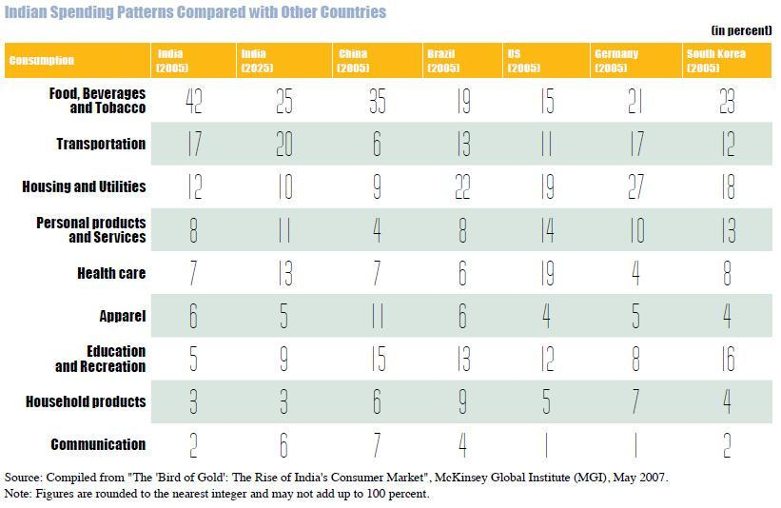
India Consumer Spending- Comparison With Other Countries
Source: The Hindu

Slide 16
Consumption, Income and Saving
Income, consumption, and saving are all closely linked. More precisely, personal saving is that part of disposable income that is not consumed; saving equals income minus consumption.
Economic studies have shown that income is the primary determinant of consumption and saving.

Slide 17
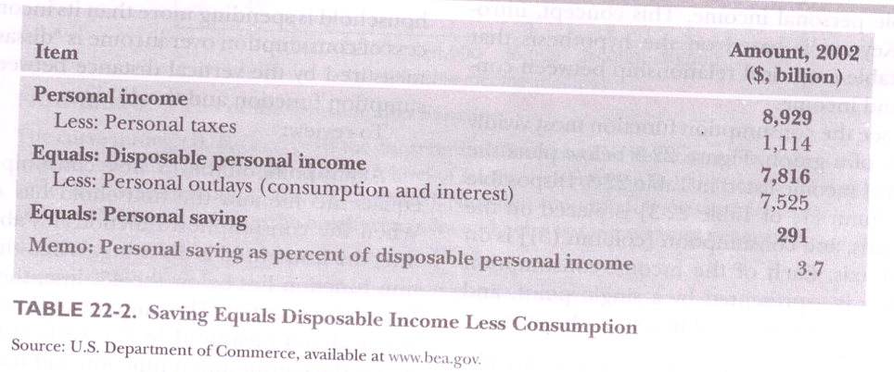
TABLE 22-2. Saving Equals Disposable Income Less Consumption

Slide 18
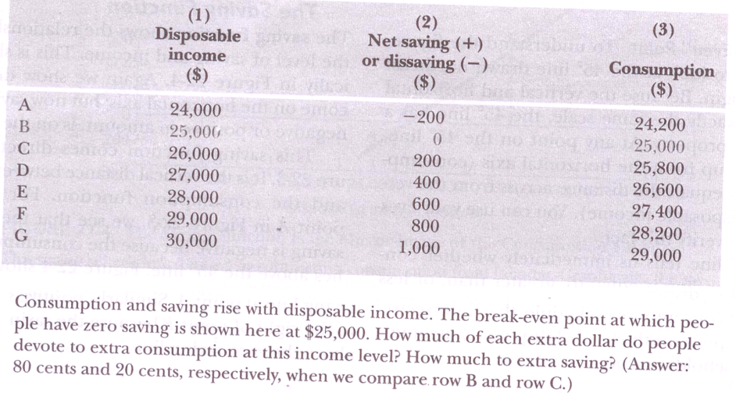
TABLE 22-3. Consumption and Saving Are Primarily Determined by Income

Slide 19
The Consumption Function
One of the most important relationships in all macroeconomics is the consumption function. The consumption function shows the relationship between the level of consumption expenditures and the level of disposable personal income.
This concept, introduced by Keynes, is based on the hypothesis that there is a stable empirical relationship between consumption and income.

Slide 20
Cont.,
We can see the consumption function most vividly in the form of a graph. Figure 22.3plots the disposable income on the horizontal axis, and consumption is on the vertical axis.
Each of the income-consumption combinations is represented by a single point, and the points are then connected by a smooth curve.
The relation between consumption and income shown in Figure 22.3 called the consumption function.

Slide 21
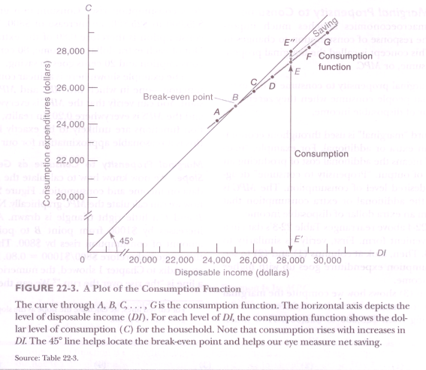
FIGURE 22-3. A Plot of the Consumption Function

Slide 22
Break -even Point
At any point on the 45° line, consumption exactly equals income and the household has zero saving.
When the consumption function lies above the 45° line, the household is dissaving.
When the consumption function lies below the 45° line, the household has positive saving. The amount of dissaving or saving is always measured by the vertical distance between the consumption function and the 45° line.

Slide 23
The Saving Function
The saving function shows the relationship between the level of saving and income. This is shown graphically in Figure 22-4. Again we show disposable income on the horizontal axis; but now saving, whether negative or positive in amount, is on the vertical axis.

Slide 24
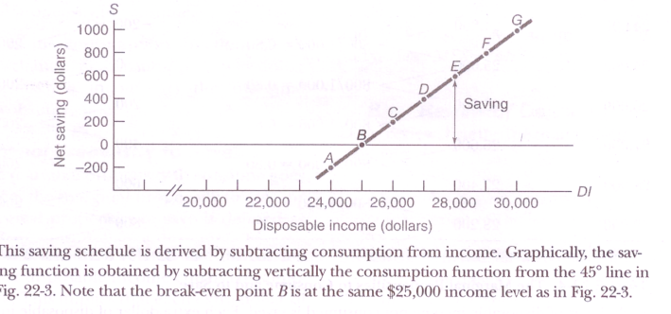
FIGURE 22-4. The Saving Function Is the Mirror Image of the Consumption Function

Slide 25
Cont.,
This saving function comes directly from Figure 22-3. It is the vertical distance between the 45° line and the consumption function. For example, at point A in Figure 22-3, we see that the household`s saving is negative because the consumption function lies above the 45° line. Figure 22-4 shows this dissaving directly—the saving function is below the zero saving line at point A. Similarly, positive saving occurs to the right of point B because the saving function is above the zero-saving line.

Slide 26
The Marginal Propensity to Consume
The MPC is the extra amount that people consume when they receive an extra dollar of disposable income.
The word “marginal” is used throughout economics to mean extra or additional.
For example “marginal Cost” means the additional cost of producing an extra unit of output.
“Propensity to consume” designates the level of consumption.
The MPC is therefore the additional or extra consumption that result from an extra dollar disposable income.

Slide 27
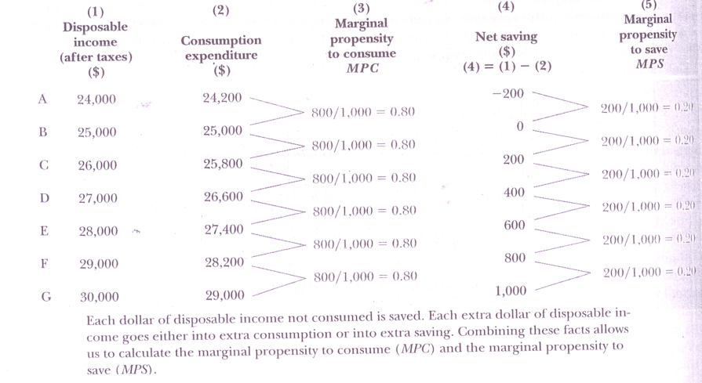
Table 22.4 the MPC and to SAVE

Slide 28
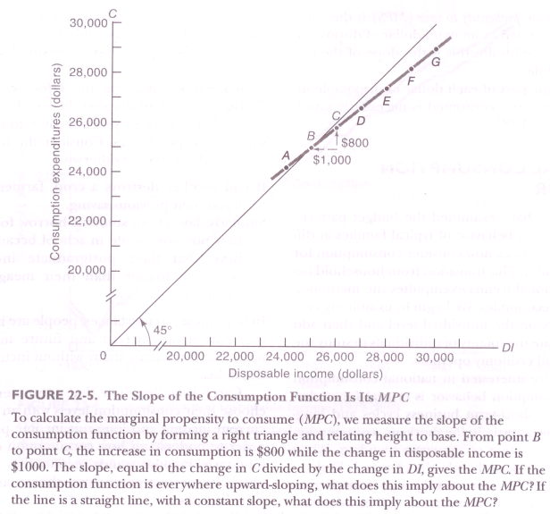
FIGURE 22-5. The Slope of the Consumption Function Is Its MPC

Slide 29
The Marginal Propensity to SAVE
The Marginal Propensity to Save MPS along with the marginal propensity to consume goes its mirror image, the marginal propensity to save. The marginal propensity to save is defined as the fraction of an extra dollar of disposable income that goes to extra saving.
Why are MPC and MPS related like mirror images? Recall that disposable income equals consumption plus saving. This implies that each extra dollar of disposable income must be divided between extra consumption and extra saving.
Thus if MPC is 0.80, then MPS must be 0.20. (What would MPS be if MPC were O.6? Or O.99?) Comparing columns (3) and (5) of Table 22-4 confirms that at any income level, MPC and MPS must always add up to exactly 1, no more and no less. MPS + MPC = 1, always and everywhere.

Slide 30
Brief Review of Definitions:
The consumption functions relates the level of consumption to the level of disposable income.
The saving function relates saving to disposable income. Because what is saved equals what is not consumed, saving and consumption schedules are mirror images.
The MPC is the amount of extra consumption generated by an extra dollar of disposable income. Graphically, it is given by the slope of the consumption function.
The ‘MPS is the extra saving generated by an extra dollar of disposable income. Graphically, this is the slope of the saving schedule.
Because the part of each dollar disposable income that in not. Consumed is necessarily saved. MPS = 1 - MPC

Slide 31
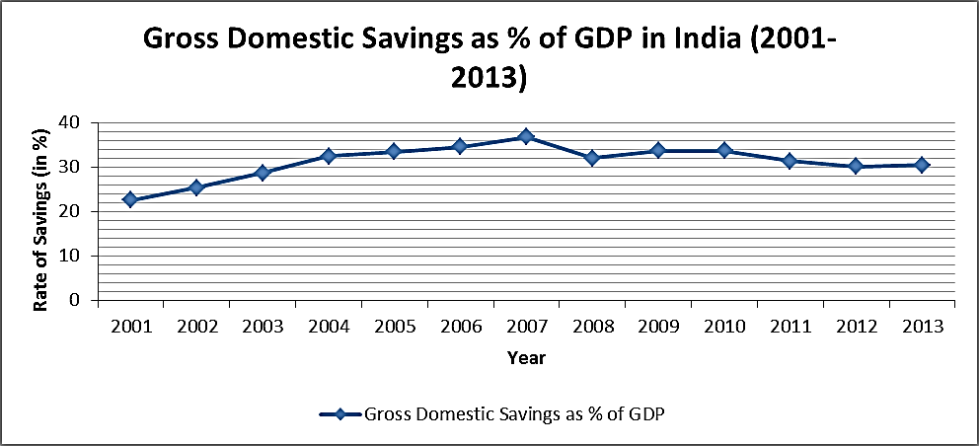
Gross Domestic Savings by Households as % of GDP in India (2001-2013)
Source: RBI

Slide 32
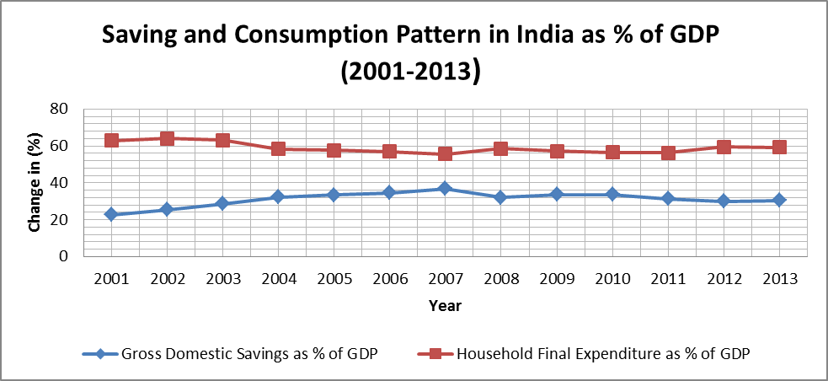
Saving and Consumption Pattern by Households in India as % of GDP (2001-2013)
Source: RBI

Slide 33
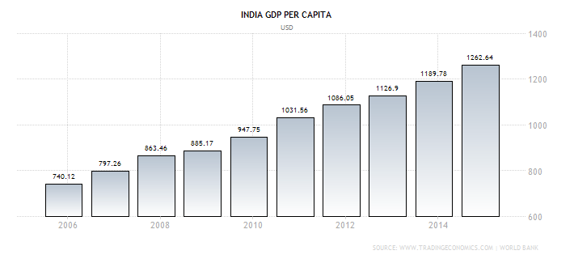
Per Capita Income of India (2006-2014)
Source: www.Tradingeconomics.com

Slide 34
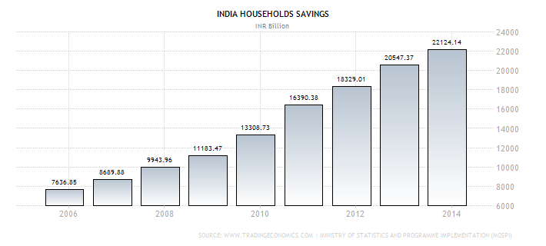
Domestic Savings by Indian Households (2006-2014)
www.Tradingeconomics.com

Slide 35
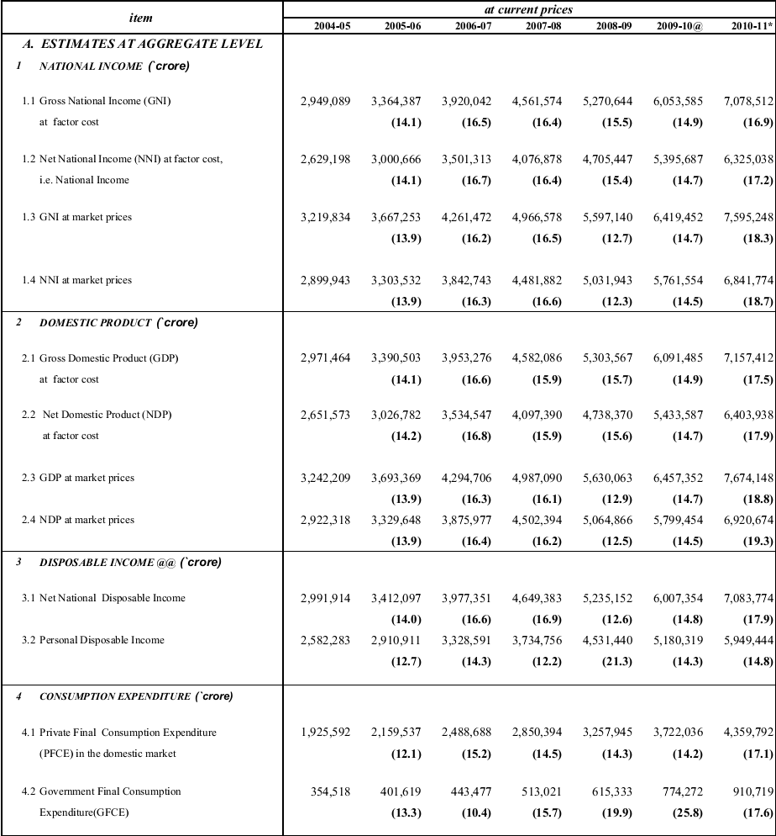
National Product, Consumption Expenditure, Saving and Capital Formation in India
Source:CSO

Slide 36
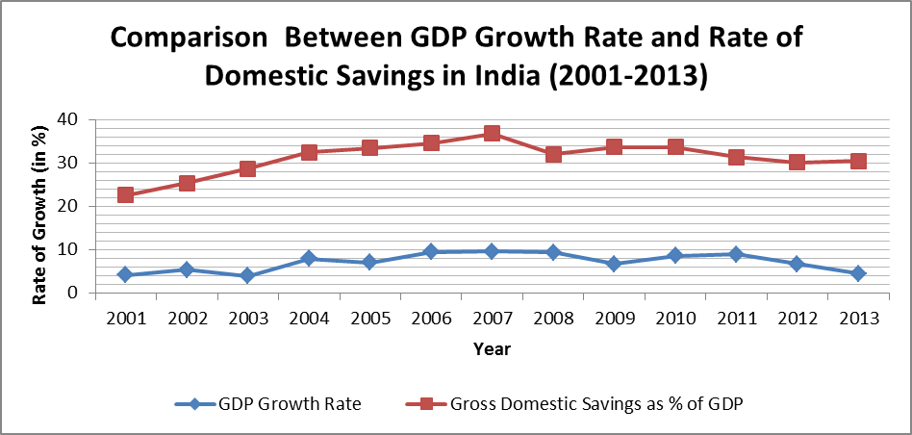
Comparison Between GDP Growth Rate and Rate of Domestic Savings in India (2001-2013)
Source: RBI and CSO

Slide 37
NATIONAL CONSUMPTION BEHAVIOR
Up to now we have examined the budget patterns and consumption behavior of typical families at different incomes, Let’s now consider consumption for the entire nation. This transition from household behavior to national trends exemplifies the methodology of macroeconomics. We begin by examining economic activity on the individual level and then add up or aggregate the totality of individuals to study the way the overall economy operates.

Slide 38
Cont.,
Why are we interested in national consumption trends?
Consumption behavior is crucial for understanding both short-term business cycles and long term economic growth. In the short run, consumption is a major component of aggregate spending.
Additionally, consumption behavior is crucial because what is not consumed—that is, saved is available to the nation for investment in new capital goods; capital serves as a driving force behind long-term economic growth.

Slide 39
Determination of Consumption Current Disposable Income
Figure 22-6 shows how closely consumption followed current disposable income over the period 1929-1999. The only period when income and consumption did not move in tandem was during World War II, when goods were scarce and rationed and people were urged to save to help the war effort .

Slide 40
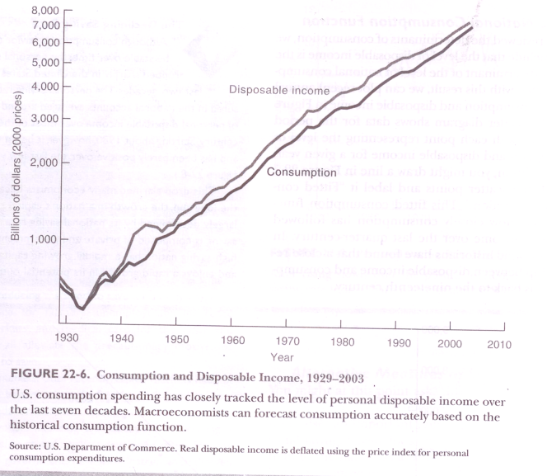
FIGURE 22-6. Consumption and Disposable Income, 1929-2003

Slide 41
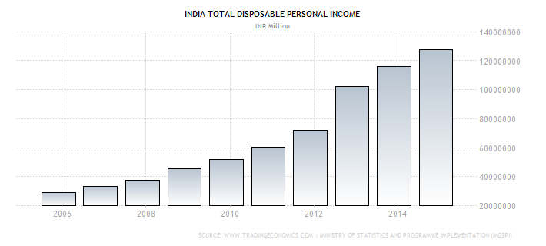
Disposable Personal Income of India (2006-2014)
Source: www.Tradingecnomics.com

Slide 42
Permanent Income and the Life-Cycle Model of Consumption.
The simplest theory of consumption uses only the current year’s income to predict consumption expenditures.
In order to understand how consumption depends on long—term income trends, economists have developed the permanent-income theory and the life- cycle hypothesis.

Slide 43
Permanent Income:
Permanent income is the trend level of income that is, income after removing temporary or transient influences due to the weather or windfall gains or losses. According to the permanent-income theory, consumption responds primarily to permanent income.
If a change in income appears permanent (such as being promoted to a secure and high-paying job), people are likely to consume a large fraction of the increase in income.
On the other hand, if the income change is clearly transitory (for example, if it arises from a one-time bonus or a good harvest), a significant fraction of the additional income may be saved.

Slide 44
Life cycle Hypothesis
The life-cycle hypothesis assumes that people save in order to smooth their consumption over their lifetime. One important objective is to have an adequate retirement income.
Hence, people tend to save while working so as to build up a nest egg for retirement and then spend out of their accumulated savings in their retirement days.
One implication of the life-cycle hypothesis is that a program like social security, which provides a generous income supplement for retirement, will reduce saving by middle—aged workers since they no longer need to save as much for retirement.

Slide 45
Wealth and Other Influence
A further important determinant of the amount of consumption is wealth. Consider two consumers, both earning RS 50,000 per year. One has RS200,000 in the bank, while the other has no savings at all. The first person may consume part of wealth, while the second has no wealth to draw down.
The fact that higher wealth leads to higher consumption is called the wealth effect.
Wealth usually changes slowly from year to year. However, when wealth grows or declines rapidly, this can cause sharp movements in consumption.

Slide 46
The National Consumption Function
Having reviewed the determinants of consumption, we may conclude that the level of disposable income is the primary determinant of the level of national consumption.

Slide 47
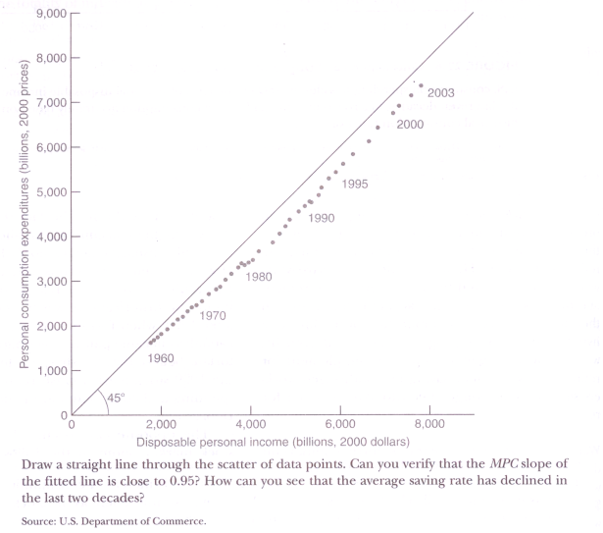
FIGURE 22-7. A Consumption Function for the United States, 1970-1999
The Declining Saving Rate: National saving is composed of private and government saving. A high-saving nation has a rapidly growing capital stock and enjoys a rapid growth in its potential output.

Slide 48
Alternative Measures of Saving
You might at this point ask, "If people are savings so little, why are there so many rich people?" This question raises an important point about measuring personal saving. Saving looks different to the household than to the nation as a whole.
This is so because saving as measured in the national income and product accounts is not the same as that measured by accountants or in balance sheets. The national-accounts measure of saving is the difference between disposable income (excluding capital gains) and consumption.
The balance sheet measure of saving calculates the change in real net worth (that is, assets less liabilities, corrected for inflation) from one year to the next; this measure includes real capital gains.

Slide 49
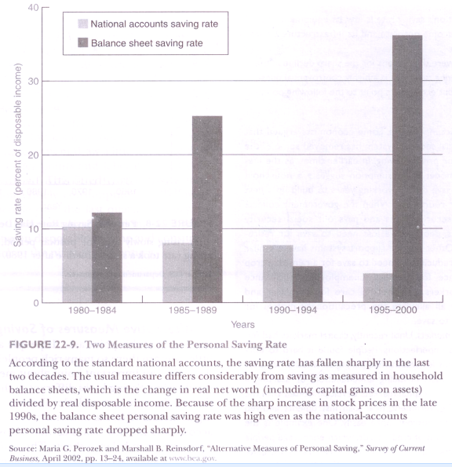
FIGURE 22-9. Two Measures of the Personal Saving Rate
Hence, economists are justified in worrying about
the decline in the national-accounts saving rate. While
consumers may feel richer because of the booming
stock market, an economy is actual richer only when
its productive tangible and intangible assets increase.

Slide 50
INVESTMENT
The second major component of private spending is investment. Investment plays two roles in macroeconomics.
First, because it is a large and volatile component of spending, investment often leads to changes in aggregate demand and affects the business cycle. In addition, investment leads to capital accumulation. Adding to the stock of buildings and equipment increases the nation’s potential output and promotes economic growth in the long run.
Thus investment plays a dual role, affecting short-run output through its impact on aggregate demand and influencing long-run output growth through the impact of capital formation on potential output and aggregate supply.

Slide 51
The Meaning of "Investment" in Economics
Remember that macroeconomists use the term "investment" or "real investment" to mean additions to the stock of productive assets or capital goods like computers or trucks. When Amazon.com builds a new warehouse or when the Smiths build a new house, these activities represent investment.
Many people speak of "investing" when buying a piece of land, an old security, or any title to property. In economics, these purchases are really financial transactions or "financial” investments," because what one person is buying, someone else is selling. There is investment only when real capital is produced.

Slide 52
Determinants of Investment
In this discussion, we focus on gross private domestic investment, which also includes foreign investment, government investment, and intangible investments in human capital and improved knowledge.
The major types of gross private domestic investment are the building of residential structures; investment in business fixed equipment, software, and structures; and additions to inventory.
The three elements essential to understanding investment: revenues, costs, and expectations.

Slide 53
The Three Essential Elements
Revenues: An investment will bring the firm additional revenue if it helps the firm sell more product. This suggests that the overall level of output (or GDP) will be an important determinant of investment.
Costs: A second important determinant of the level of investment is the costs of investing. Because investment goods last many years, reckoning the costs of investment is somewhat more complicated than doing so for other commodities like coal or wheat.

Slide 54
Cont.,
Expectations: The third element in the determination of investment is profit expectations and business confidence. Investment is, above all, a gamble on the future, a bet that the revenue from an investment will exceed its Costs.

Slide 55
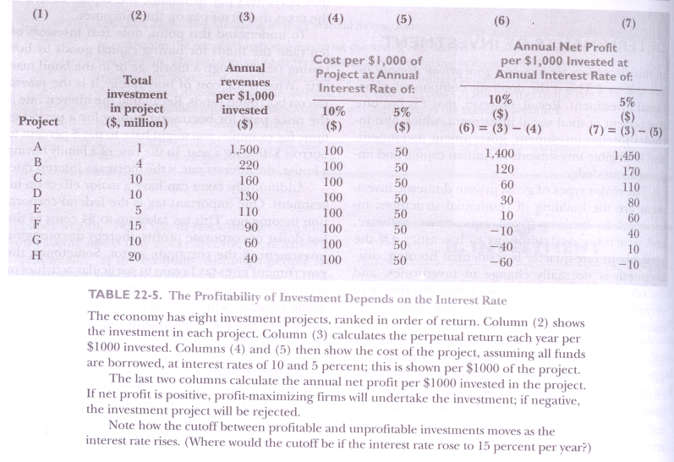
TABLE 22-5. The Profitability of Investment Depends on the Interest Rate

Slide 56
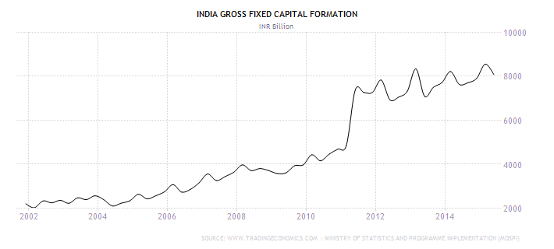
Gross Fixed Capital Formation (Investment) in India (2002-2014)
Source: www.Tradingeconomics.com

Slide 57
Cont.,
To review our findings: In choosing among investment projects, firms compare the annual revenues from an investment with the annual cost of capital, which depends upon the interest rate.
The difference between annual revenue and annual cost is the annual net profit.

Slide 58
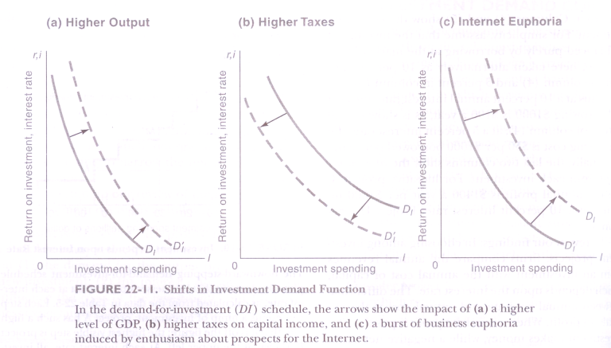
FIGURE 22-I I. Shifts in Investment Demand Function

Slide 59
ON TO THE THEORY OF AGGREGATE DEMAND
We have now completed our introduction to the basic concepts of macroeconomics. We have examined the determinants of consumption and investment and seen how they can fluctuate from year to year.

Slide 60
A.P.C and A.P.S
C= f (Y), where Y is disposable income.
C = 10 + ¾ Y
Calculate MPS and MPC?
C/Y and S/Y are the A.P.C and A.P.S.
Calculate the saving function?
S = Y – C= Y – (10 + ¾ Y) = - 10 + ¼ Y
A part of consumption spending will be independent of current income. This is autonomous consumption. Here autonomous C is 10.The other part (=3/4Y) is induced by income.

Slide 61
Similarly, autonomous investment is the level that does not change with current Y.
C = 10 + ¾ Y
Let Investment I = 20
The AD function is C + I = 30 + ¾ Y.
We now relax the assumption that investment is entirely autonomous and allow it to be influenced by current income. Then it will be induced investment.

